Slide 1
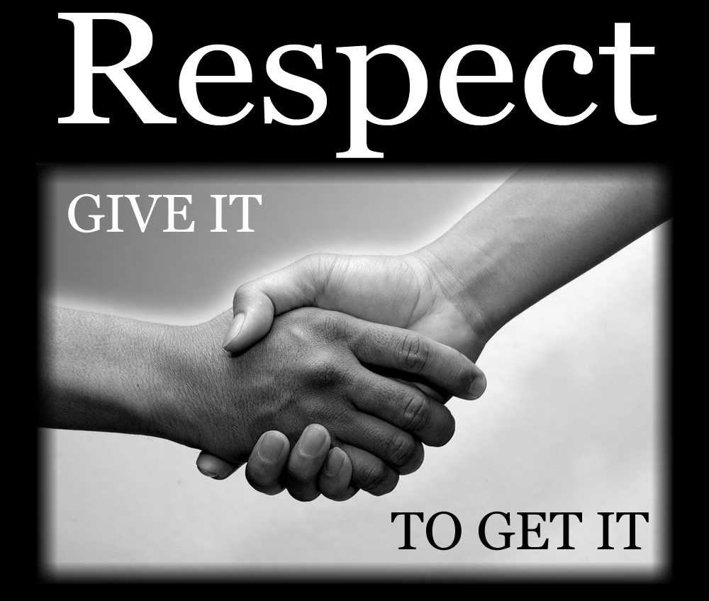

Slide 2
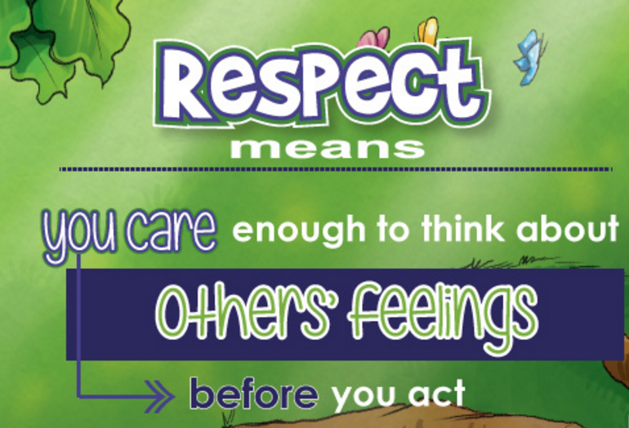
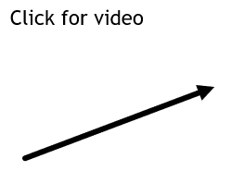
What does Respect mean?

Slide 3
Why is RESPECT important?
Respect is important because:
    It helps us build positive relationships.
    It makes our environment friendly and safe.
    It makes everyone feel included.

Slide 4
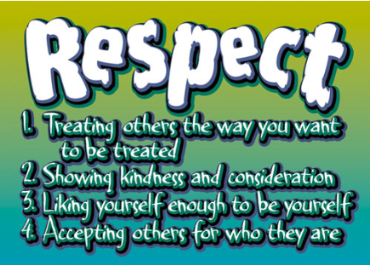
Ways to show respect…

Slide 5

Respecting Differences
Click for video

Slide 6
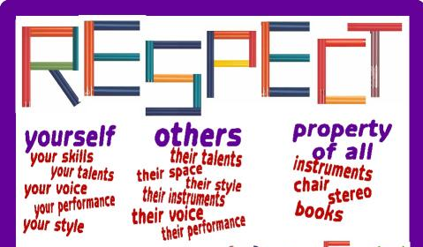

Slide 7
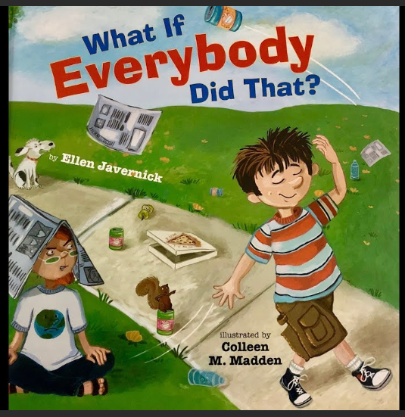
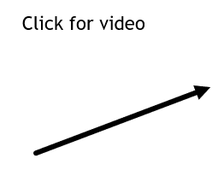
Literature Connection

Slide 8
